Slide 1


CVCS Escapement Modeling
Testing the CVCS Escapement Model
Presented by:
Arthur Barros, California Department of Fish and Wildlife
Arthur.Barros@wildlife.ca.gov

Slide 2
Comparing our code to escapeMR
Optimization algorithm:
escapeMR: VA09AD (FORTRAN)
R optim: Broyden-Fletcher-Goldfarb-Shanno (BFGS)

Slide 3
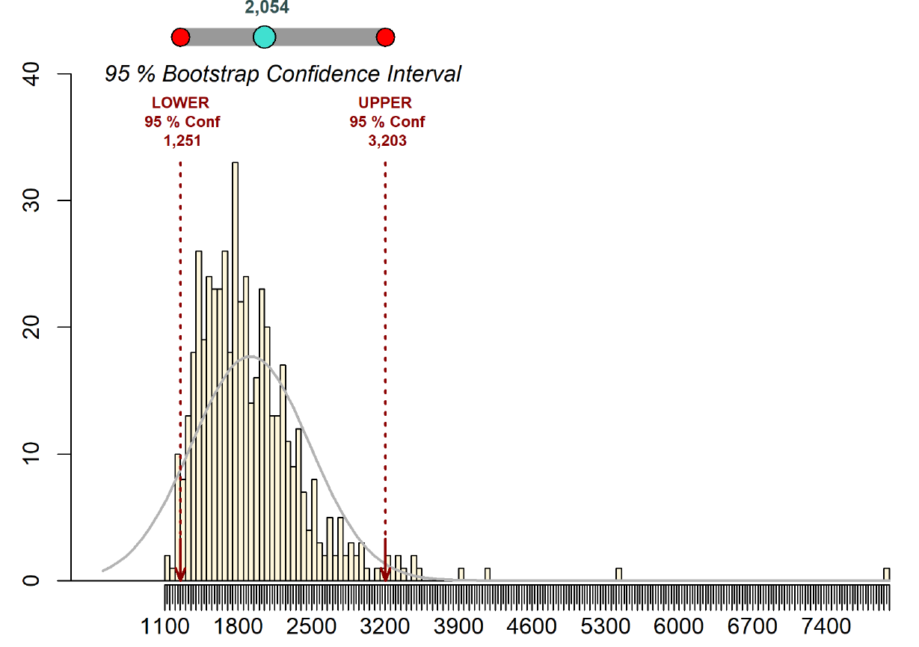
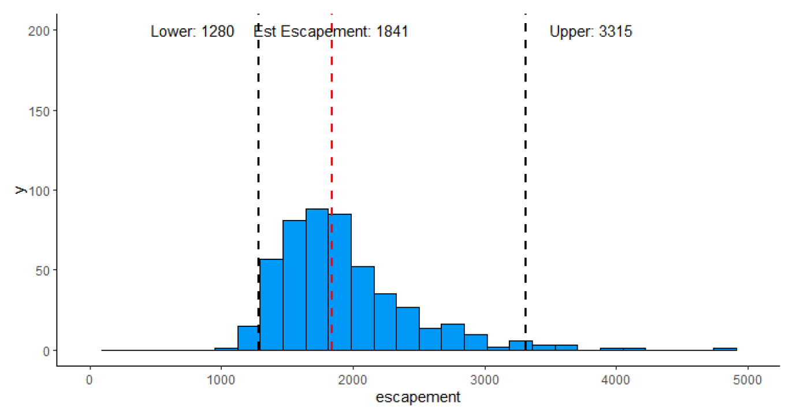
Comparing our code to escapeMR
Demo data; nan=153, ns=5, chops=221, 500 iterations

Slide 4
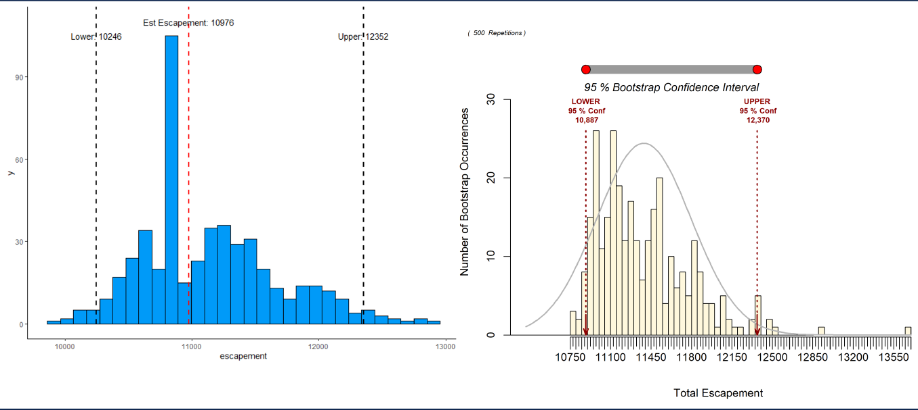
Comparing our code to escapeMR
American R. 2021; nan=1359, ns=12, chops=3885, 500 iterations

Slide 5
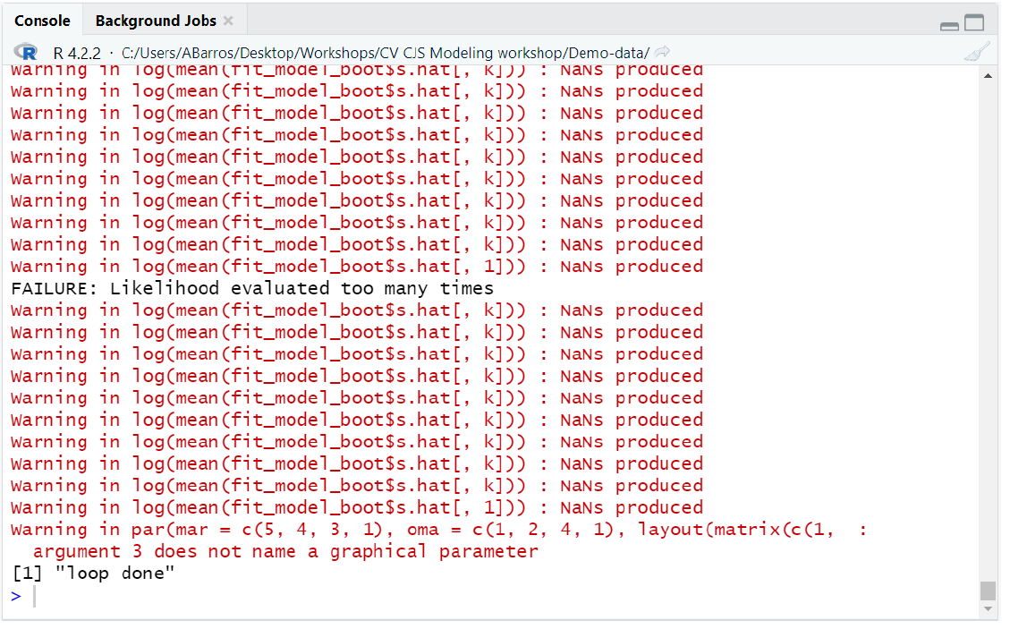
escapeMR failure to converge
ARC 2021, 500 iterations

Slide 6

Simulating a population with ch_sim()

